Slide 1
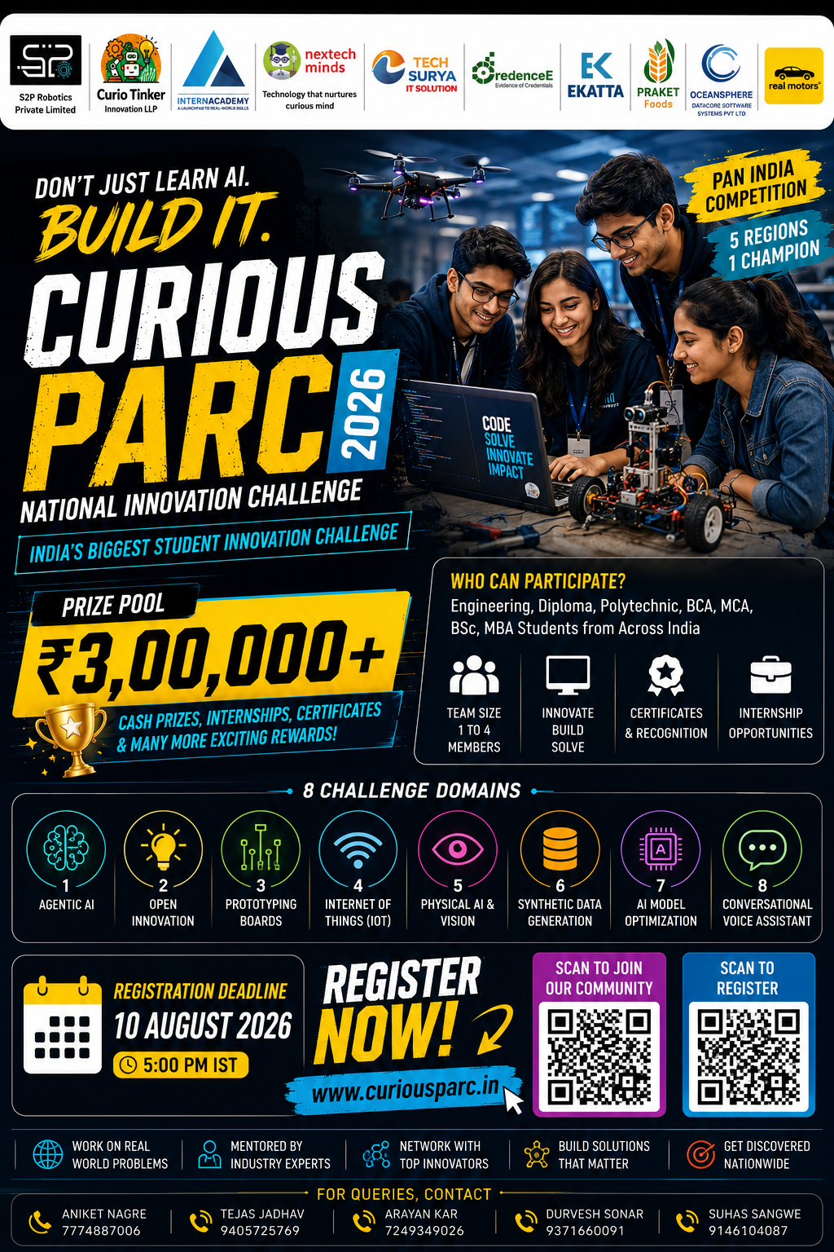

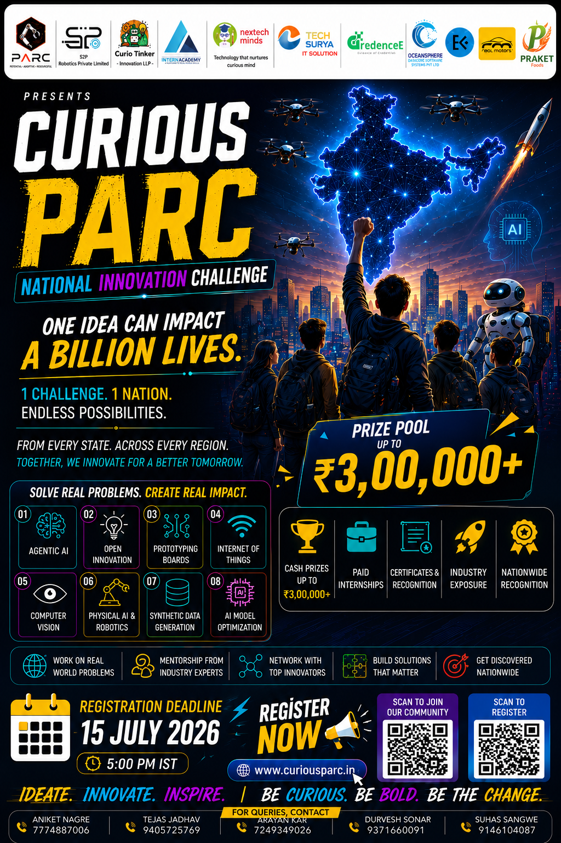



CURIOUSPARC 2026
CURIOUSPARC 2026 • State Innovation Challenge
PARTICIPANT
PROJECT PITCH
INDRADHANU
Offline Disaster Management Agentic System
TEAM
Team Kala Dhua
Ayush Pathak · Tushar Singh · Shreeviraj Matale · Piyush Mishra
One Idea Can Impact a Billion Lives.
CURIOUSPARC 2026 • State Innovation Challenge
01

Slide 2








Problem Statement & Current Gaps
CP 2026
When floods and landslides hit, the network fails first — exactly when coordination is needed most.
The Problem
Current Gaps
Towers and power go down first. Control rooms lose sight of the ground, reports arrive late, duplicated or fake, and rescue crews are sent down roads that are already cut off.
Today
What breaks
SMS / cell-broadcast alerts
One-way: nothing comes back from the ground
GIS dashboards & DSS
Need internet; allocation is still manual
Target Users
District control rooms
Ward officers
NDRF · SDRF · Fire · 108
WhatsApp & phone calls
Unverified, duplicated, no audit trail
Citizens in low-lying areas
Relief camps & hospitals
Forecast models (IMD, GloFAS)
Predict the hazard, but don't dispatch or track roads
Why Now?
Extreme rain events are more frequent
Every phone has Bluetooth: a free offline network
Vision AI + agents now run on a laptop
Citizens, crews and control room see different pictures
Single-purpose apps
CURIOUSPARC 2026 • State Innovation Challenge
02

Slide 3







Our Solution & Key Features
CP 2026
An agentic system that keeps disaster response running when the internet does not.
We solve network-blind disaster response by using a Bluetooth mesh, on-device vision AI and LangGraph agents to help control rooms, crews and citizens act on verified ground truth.
03
Simple
03
Smart
03
Practical
03
Scalable
One-tap SOS that works with zero signal
Agents verify, prioritise and plan; officer approves IF NEEDED
Crews get routes that avoid blocked roads
Any district, any hazard — by configuration
KEY FEATURES
VALUE FOR USERS
Offline mesh SOS
Camera sentinel
Trust & de-dup
Faster: units tasked in seconds, not phone rounds
Safer: no crew sent into a blocked road
Cheaper: phones + open data, no new towers
Accountable: every decision logged and replayable
bitchat BLE mesh relays reports phone-to-phone
YOLO + local VLM describes the scene
Fakes quarantined; 10 calls → 1 incident
Explained warnings
Smart dispatch
Human in control
Rain, river, terrain + confidence
CP-SAT picks units on open roads
Approvals + one-click emergency stop
CURIOUSPARC 2026 • State Innovation Challenge
03

Slide 4
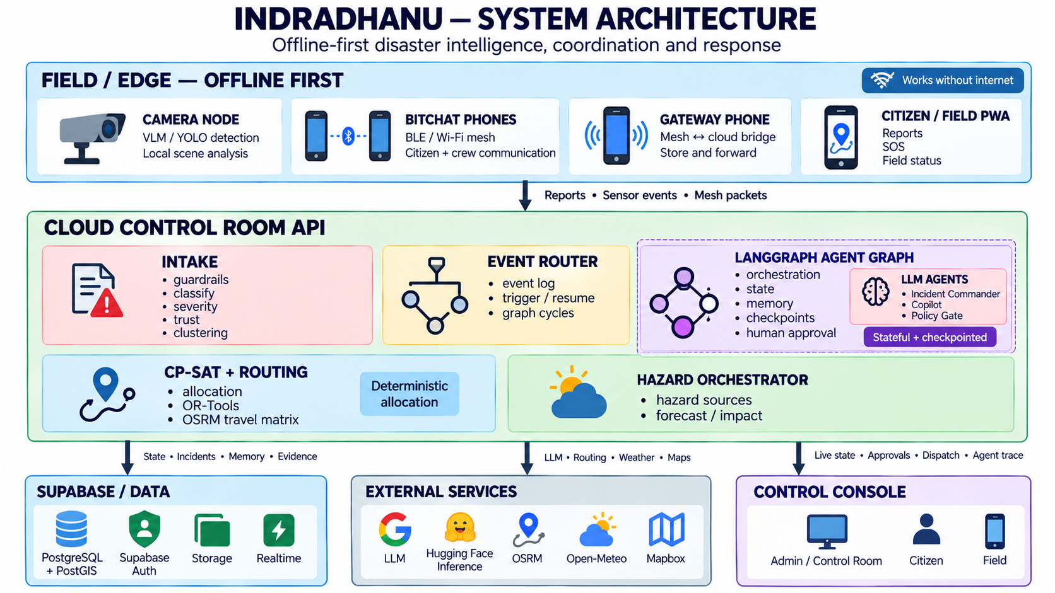
Technology & Innovation
CP 2026
System architecture — offline-first edge, cloud control room, one shared picture.
INPUT
Mesh SOS, citizen & crew apps, cameras, hazard feeds
PROCESS
Guardrails → classify → severity → trust → cluster
MODEL
LangGraph agents + CP-SAT optimiser + XLM-R / LLM
OUTPUT
Dispatch, safe routes, alerts — back over the mesh
TECH STACK
USP: works with no internet — the mesh carries reports and orders; any phone that finds signal syncs the whole area.
FastAPI
LangGraph
OR-Tools CP-SAT
PostGIS
Supabase
React + Vite
Mapbox / OSRM
Open-Meteo · GloFAS
bitchat BLE
YOLO + Qwen2.5-VL
CURIOUSPARC 2026 • State Innovation Challenge
04

Slide 5
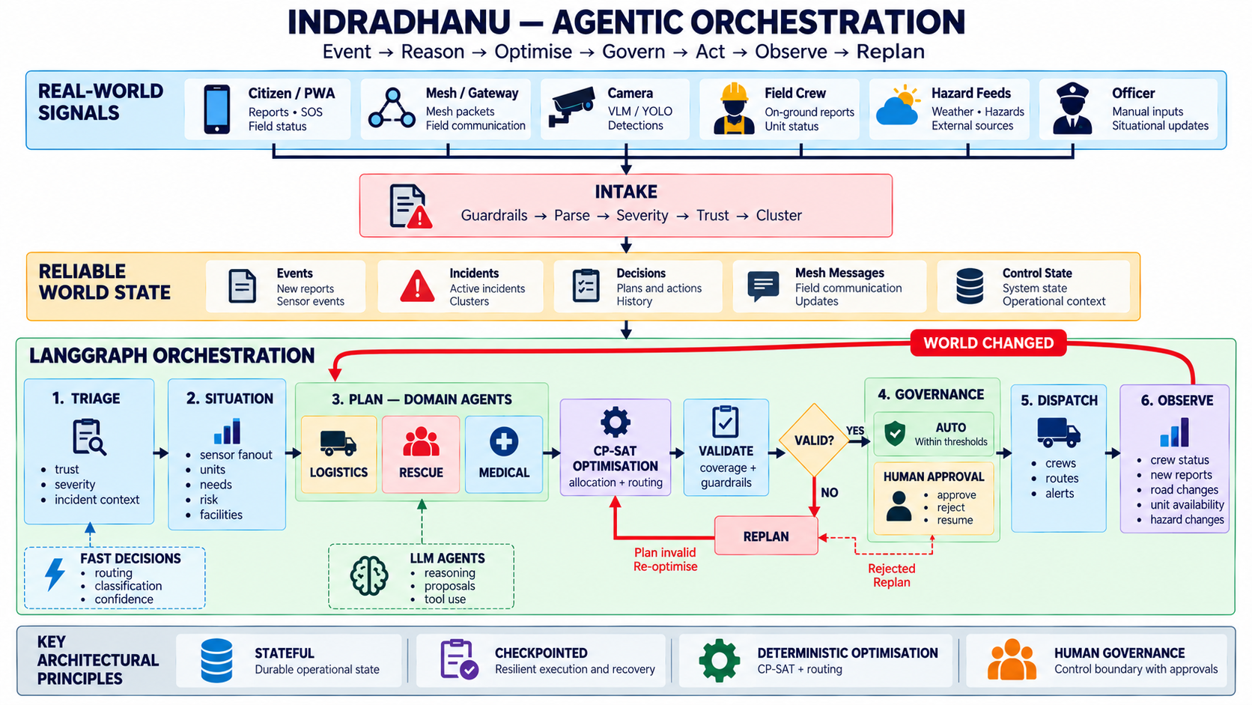



Technology & Innovation
CP 2026
Agentic orchestration — event → reason → optimise → govern → act → observe → re-plan.
WHY IT IS SAFE
Strict state
each agent declares what it reads & writes
Guardrails
input, output, action and run limits
Scoped memory
agents see only their namespace
Officer approval
high-severity actions wait for a human
Emergency stop
“stop everything” halts all autonomy
Innovation gap: most tools stop at an alert. Indradhanu closes the loop — it plans, dispatches, watches the result and re-plans on its own, while a named officer keeps the final say.
Deterministic core: allocation is solved by CP-SAT, not guessed by an LLM.
CURIOUSPARC 2026 • State Innovation Challenge
05

Slide 6
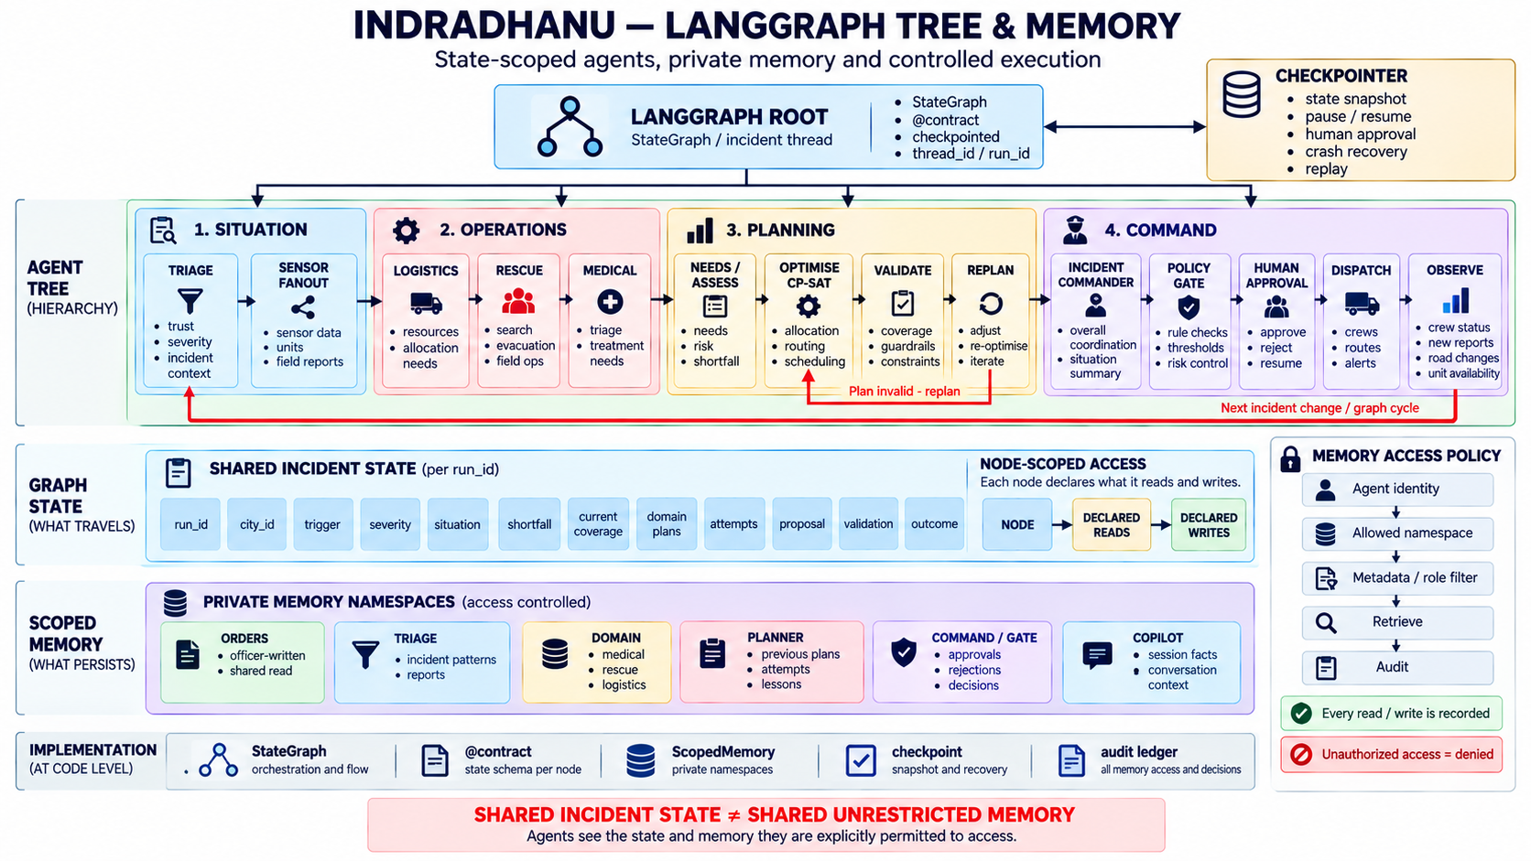

Technology & Innovation
CP 2026
LangGraph tree — state-scoped agents, private memory and controlled execution OUR VERY OWN ARCHITECTURE
Agent tree
Situation → Operations → Planning → Command
Shared state
one incident state per run, typed & validated
Private memory
orders, triage, planner, command — access-controlled
Audit ledger
every memory read & write is recorded
Shared incident state ≠ shared unrestricted memory — agents see only what they are permitted to.
CURIOUSPARC 2026 • State Innovation Challenge
06

Slide 7










Prototype / Demo & Status
CP 2026
Working product, live today — every portal below is clickable.
1 Report offline
2 Mesh relays
3 Agents plan
4 Crew dispatched
SOS / camera alert with no signal
hops phone-to-phone to a gateway
verify, prioritise, solve, approve
route on open roads, back over mesh
PROJECT PORTALS
CURRENT STATUS
Demo video
Citizen app (no login)
https://drive.google.com/drive/folders/12MbQUQqs_3_cTMILaBvAZddjNXXzcDE4?usp=sharing
distro-ruddy.vercel.app/citizen
IDEA
Field crew app
Command wall (control room)
PROTOTYPE
distro-ruddy.vercel.app/field
distro-ruddy.vercel.app/admin/wall
Live map & console
Agent graph
MVP
distro-ruddy.vercel.app/admin/console
distro-ruddy.vercel.app/admin/graph
WORKING PRODUCT
Mesh & devices
Backend API
distro-ruddy.vercel.app/admin/mesh
disruptionops.onrender.com/api/v1
Live in 2 regions: Pune (16 wards) and Ghaziabad (14 wards).
Mesh APK + camera node tested in the field.
Platform code
github.com/officialayush23/DisruptionOps
CURIOUSPARC 2026 • State Innovation Challenge
07

Slide 8


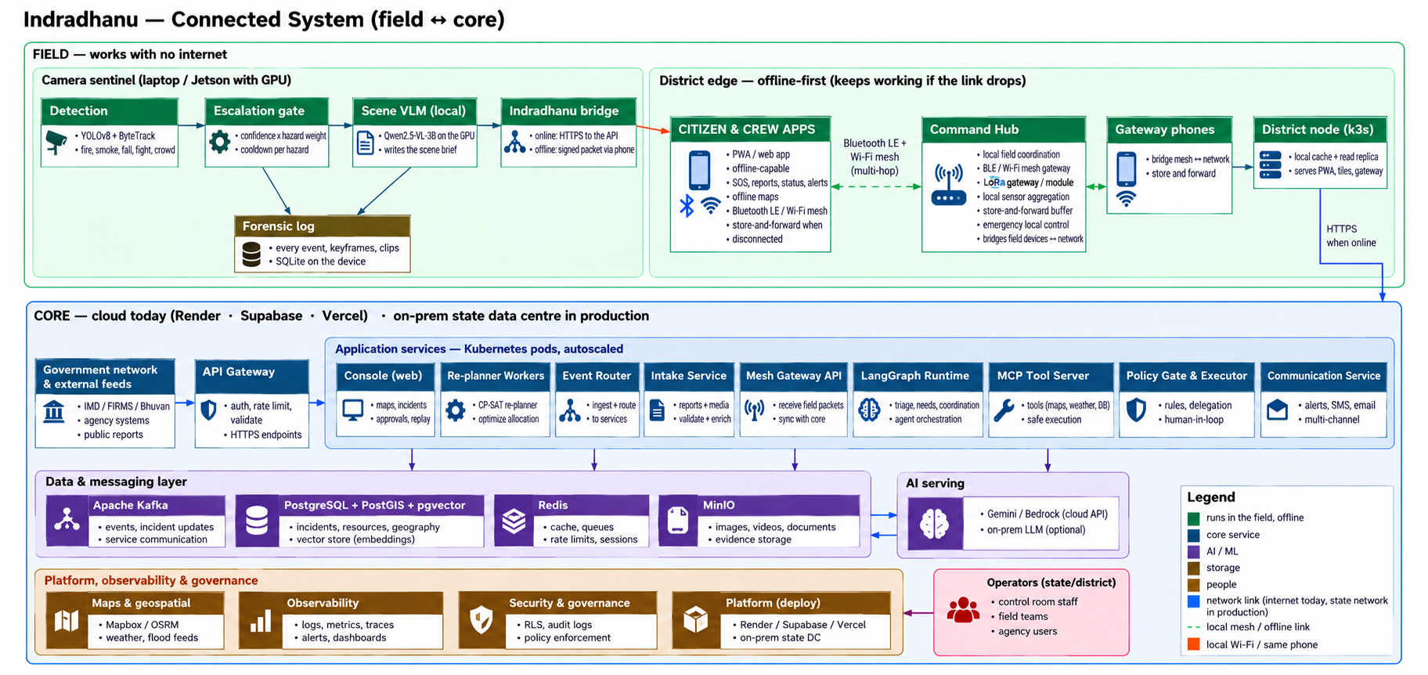
Impact, Feasibility & Roadmap
CP 2026
Measured results today, and a realistic path from campus pilot to state rollout.
NOW
NEXT
PHASE 3
FUTURE
MVP live
Field testing
District pilot
Scale
Pune + Ghaziabad regions, mesh + camera node
college & ward teams, monsoon drills
state data centre, on-prem LLM, k3s edge
statewide; plug into SDMA / NDMA systems
IMPACT
FEASIBILITY
384/384
2.8%
dispatch routes on real, open roads
reports quarantined as untrustworthy
347
0
incidents handled end-to-end
internet needed at the edge
Lives & time: help reaches the right street faster, no double-dispatch, and every decision can be audited.
Tech: deployed and running (Render, Supabase, Vercel)
Budget: free tiers today; phones + open data at the edge
Ops: same stack moves to a state data centre
CURIOUSPARC 2026 • State Innovation Challenge
08

Slide 9
Team & Partners
CP 2026
Introduce the people behind the idea and acknowledge official event partners.
TEAM ROSTER
OFFICIAL PARTNERS / SPONSORS
Ayush Pathak -- Backend, agents & control room
S2P Robotics
Curio Tinker
Tushar Singh -- Offline mesh
InternAcademy
Nextech Minds
Shreeviraj Matale - Database
Tech Surya
CredenceE
EKATTA
Praket Foods
Piyush Mishra -- Research
Oceansphere
Real Motors
Team Kala Dhua
CURIOUSPARC 2026 • State Innovation Challenge
09

Slide 10
CURIOUSPARC 2026
Thank You
CURIOUSPARC 2026
Official Partners & Sponsors
Indradhanu
S2P Robotics
Curio Tinker
When the network falls, help still reaches the right street.
InternAcademy
Nextech Minds
TEAM CONTACT
Email: officialayushp123@gmail.com
Project Demo: https://drive.google.com/drive/folders/12MbQUQqs_3_cTMILaBvAZddjNXXzcDE4?usp=sharing
Live platform: distro-ruddy.vercel.app
Project Resources: GitHub — DisruptionOps ·
API: disruptionops.onrender.com/api/v1
Tech Surya
CredenceE
EKATTA
Praket Foods
Oceansphere
Real Motors
VIT Pune
Christ University
One Idea Can Impact a Billion Lives.
CURIOUSPARC 2026 • State Innovation Challenge
10

